Slide 1
Mobile Food Truck Safety Training
Part 5: Fire Extinguisher Training
This material was produced under grant number SH-39170-SH2 from the Occupational Safety and Health
Administration, U.S. Department of Labor. It does not necessarily reflect the views or policies of the U.S.
Department of Labor, nor does mention of trade names, commercial products, or organizations imply
endorsement by the U.S. Government.

Slide 2
Objectives
After this module, the trainee will be able to:
Review the EAP Decision whether employees will fight fires or evacuate
Identify the three requirements for a fire to continue
Classify types of fires by their characteristics
Identify the types of fire extinguishers needed for their business
Operate a fire extinguisher
Identify conditions when NOT to fight a fire

Slide 3
Purpose of a Fire Extinguisher
Two functions:
To control or extinguish small or incipient stage fires and,
To protect evacuation routes that a fire may block directly or indirectly with smoke or burning materials.
Fire extinguishers are designed to put out or control small fires
If not controlled immediately, small fires can spread out of control
Facilities need the proper types and placement of fire extinguishers as part of a fire protection plan

Slide 4
Review: Emergency Action Plans (EAP)
Decision: Should employees evacuate or be prepared to fight small fires?
This module will address Fire Extinguisher Training for those authorized to use them
 | Option 1 | Option 2 | Option 3
Who uses fire extinguishers? | Nobody | Only designated workers can use | All employees are authorized to use
Who evacuates? | Everyone | All others not authorized | Anyone not authorized
EAP, Fire Prevention, and Training Required? | Yes | Yes | Yes
Worker Fire Extinguisher Training Required? | No | Each authorized employee must be trained annually | All authorized employees must be trained annually
Additional Requirements | Fire Extinguishers must be inspected, tested, and maintained.
Notes:
Recommendations can be found here: https://www.osha.gov/etools/evacuation-plans-procedures/eap/fight-or-flee
There is a 4th option: Extinguishers are provided but not intended for employee use. While this may be added to the list of options, it may just add confusion to the response needed, which is why it is not included here.

Slide 5
Definitions
OSHA
"Incipient stage fire“ means a fire in the initial or beginning stage and can be controlled or extinguished by portable fire extinguishers, Class II standpipe, or small hose systems without the need for protective clothing or breathing apparatus.
NFPA
“Incipient stage fire” A fire is beyond the incipient stage when the use of thermal protective clothing or self-contained breathing apparatus is required...

Slide 6
Fire Triangle: Fire Needs 3 Elements
Fire requires 3 Elements:
Take one away → fire cannot survive
Fuel: Without fuel, a fire will stop.
Oxygen: Without sufficient oxygen, a fire can’t begin, and it can’t continue.
Heat: Without sufficient heat, a fire can’t begin, and it can’t continue.
Our strategy in Fire Extinguisher use: →Remove one or more of the elements before a fire can spread out of control.
Notes:
https://www.osha.gov/etools/evacuation-plans-procedures/emergency-standards/portable-extinguishers/about

Slide 7
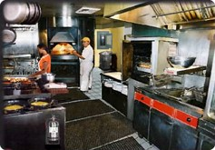
Five Fire Categories
What’s Present in Your Operation?
Yes | No | Fire Class | Materials
 |  | Class A Fires | Combustible materials (wood, cloth, paper, rubber and many plastics)
 |  | Class B Fires | Flammable Liquids (gasoline, kerosene, propane, alcohols)
 |  | Class C Fires | Electrical equipment
 |  | Class D Fires | Metals (magnesium, sodium, lithium)
 |  | Class K Fires (Kitchen) | Grease/Cooking Oils
How likely for each to be present in most Food Trucks?
Notes:
https://www.osha.gov/etools/young-workers-restaurant-safety/cooking
Class D Fire Materials would be least likely to be found in Mobile Food Vehicles (MFVs)
Class A is most likely to be found in any business (paper at minimum)
The others may depend on the individual business

Slide 8
Types of Fire Extinguishers
Fire extinguishers must be matched to the hazards present
Types:
Class A- Wood, Paper, Plastics (Water)
Class AB- Wood, Paper, and Flammables (CO₂)
Class BC- Flammables + Electrical (CO₂)
Class ABC- Multipurpose (Chemical Powder)
Class K- Kitchen Fires (Wet Chemical)
Class D- Metal Fires
Simplify?
A
B
C
D
K
Notes:
Failure to match the fire extinguisher to the hazard can be deadly
Example 1. Using a water-based extinguisher on a Class B or Class K Fire will cause it to spread (oil and water don’t mix) and may cause spattering due to rapid steam generation
Example 2. Using a water-based extinguisher on an electrical fire may result in electrocution, since water is a good conductor
Example 3. Reactive metals like sodium and lithium produce explosive hydrogen gas when contacting water

Slide 9
Fire Extinguisher Types
Fire extinguishers must be matched to the hazards present
Types:
Class A- Wood, Paper, Plastics (Water)
Class AB- Wood, Paper, and Flammables
Class BC- Flammables + Electrical (CO₂)
Class ABC- Multipurpose (Chemical Powder)
Class K- Kitchen Fires (Wet Chemical)
Class D- Metal Fires
A
B
C
K
Notes:
Failure to match the fire extinguisher to the hazard can be deadly
Example 1. Using a water-based extinguisher on a Class B or Class K Fire will cause it to spread (oil and water don’t mix) and may cause spattering due to rapid steam generation
Example 2. Using a water-based extinguisher on an electrical fire may result in electrocution, since water is a good conductor
Example 3. Reactive metals like sodium and lithium produce explosive hydrogen gas when contacting water

Slide 10
Class ABC Extinguisher
A
B
C
Multipurpose
Wood, paper
Flammable Liquid
Electrical
Contains Dry Chemical
Fire retardant powder separates the fuel from oxygen
Pressure Gauge Verifies Fill Level
Note: Mildly Corrosive (Electronic Equipment)

Slide 11
Class K Extinguisher
Class K= Kitchen
Cooking Oils/Fats
Required for all solid fuel cooking with a fire box volume of 5 cubic feet or more (Regardless of whether hood present)
Mixture of dry and wet chemicals
Electrically conductive
Electrical power to the appliance must be shut off first
Pressure Gauge Verifies Fill Level
Fires burn at very high temperature
Agent cools and separates fuel/oxygen
K

Slide 12
Location and Placement
Must be readily accessible and visible if fire occurs
Near kitchen locations, no more than 30 ft away
Bottom must be at least 4 inches off the floor
Fire extinguisher weighing < 40lb (Lighter)
Top cannot be more than 5 ft from floor
Fire extinguisher weighing > 40lb (heavier)
Top cannot be more than 3.5 ft from floor

Slide 13
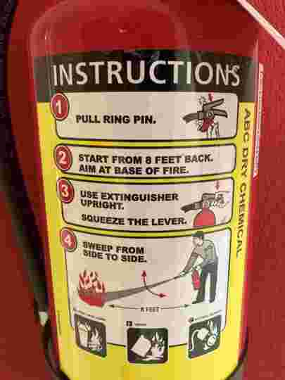
Procedures to Respond to a Fire
If nobody is authorized to use a fire extinguisher, everyone must evacuate
If someone is authorized and trained to use a fire extinguisher:
1) Sound an alarm, call the fire department
2) Identify a safe evacuation path before approaching a fire.
Do not allow the fire, heat, or smoke to come between you and evacuation path
3) Select the appropriate fire extinguisher
To use Class K Extinguisher, electricity must be off to that appliance
4) Discharge the extinguisher using the P.A.S.S. technique
5) Back away from an extinguished fire if it reignites
**Evacuate immediately if the extinguisher is empty and fire is not out
**Evacuate immediately if the fire progresses beyond the incipient stage
Notes:
These recommendations may differ from building fires
A second acronym is R.A.C.E.:
R.A.C.E
Rescue anyone in immediate danger of the fire
Alarm needs activated AND call fire response phone number
Contain fire by closing all doors in the fire area
Extinguish small fires. If fire cannot be extinguished, leave the area and close the door.

Slide 14
Is it safe to fight a fire?
Criteria | Safe | NOT Safe
Size of Fire | Fire has not spread Flames not higher than head | Fire has spread beyond origin Flames reaching the ceiling
Air Conditions | Smoke present, but clear view of the fire No respiratory protection needed | Smoke blocking view of fire Air is difficult to breathe Respiratory protection needed
Exit Path | Clear exit path behind you | Exit path behind you is not safe Fire is not contained, spreading
If you have the slightest doubt about your ability to fight a fire or the
conditions present, EVACUATE IMMEDIATELY!

Slide 15
Use P.A.S.S. for Small Fires
Pull Pull the pin.
Aim Aim extinguisher nozzle or hose at the base of the fire.
Squeeze Squeeze handle to release the extinguishing agent.
Sweep Sweep sideways at the base of the fire until it is out.
Watch the area.
If the fire re-ignites, repeat the above.

Slide 16
Inspection, Maintenance, and Testing
The employer is responsible for the inspection, maintenance, and testing of portable fire extinguishers in the workplace
Monthly inspections
Annual Inspections

Slide 17
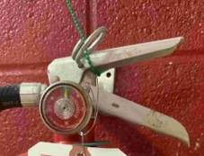
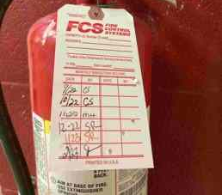
Monthly Inspections
Check/Date | Description
 | Is the Fire Extinguisher in its designated place?
 | No obstruction to access or visibility?
 | Is the pressure gauge showing that the extinguisher is fully charged (the needle should be in the green zone)?
 | Is the pin and tamper seal intact?
 | Is the extinguisher in good condition and showing no signs of physical damage, corrosion, or leakage?
*Tag on Extinguisher or Paper/Electronic Files are both acceptable
*Need: Month/year of inspection and person conducting inspection

Slide 18
Annual Inspections
Annually:
Use a 3rd party for annual maintenance checks
-Annual fire department inspections
Ensure backup protection when fire extinguishers are removed for maintenance or recharging
Hydrostatic Testing:
This is a pressure-testing technique used to test for strength and leaks in pressure vessels like gas cylinders.
Must be performed by someone with suitable equipment/facilities.
Performed every 5-12 years, depends on extinguisher

Slide 19
Training on Fire Extinguisher Use
Authorized Workers must be trained on how to use a fire extinguisher
This training does not have to be performed on live fires.
Our training will begin in a few minutes

Slide 20
To Summarize:
EAPs must describe whether workers will use fire extinguishers for fires
Fire extinguishers are only to be used on small (incipient) fires and when a clear exit path is present.
The type(s) of fire extinguishers needed depends on the materials present.
For most food trucks, a Class ABC (dry powder) extinguisher will be needed, and possibly a Class K extinguisher if cooking oils are present.
The P.A.S.S. method should be used to extinguish small fires.
Employees must be trained on how to use fire extinguishers.

