Slide 1
Mobile Food Truck Safety Training
Part 4: Propane Tank Safety
This material was produced under grant number SH-39170-SH2 from the Occupational Safety and Health
Administration, U.S. Department of Labor. It does not necessarily reflect the views or policies of the U.S.
Department of Labor, nor does mention of trade names, commercial products, or organizations imply
endorsement by the U.S. Government.
Notes:
This section will take ~20-25 minutes, depending on questions that trainees may have about individual circumstances

Slide 2
Objectives
After this module, the trainee will be able to:
Identify basic properties of propane and hazards associated with propane tank usage
Recognize and use hazard controls to reduce the risk from those hazards

Slide 3
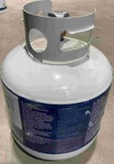
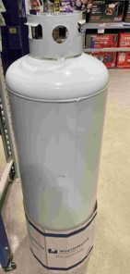
Propane Tank Safety
Propane: A Hazardous Material that Deserves Respect
Propane is one kind of Liquefied Petroleum Gas (LP-Gas) that may be transported in tanks and is used in cooking operations
According to NFPA, 68% of food truck fires are the result of leaks or structural failures of propane tanks
A 20-pound propane tank = explosive energy of 120 sticks of dynamite
Note: Personal Injury Lawyers are starting to add Food Truck Accidents as a specialty litigation service
DISCLAIMER: State and Local Regulations may vary; the guidance provided here are based on NFPA guidance AND the expectation that managers will refer to local authorities and properly trained professionals when necessary.

Slide 4
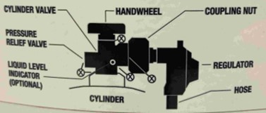
What makes a propane tank hazardous?
Propane is a gas at room temperature
Priced by the gallon, but sold by the weight
1 pound of propane = 0.236 gallons (60ºF), so 100 lb= 23.6 gallons
1 gallon= 4.24 lbs (gas is heavier than air, but lighter than water)
Propane is pressurized to be in liquid state inside the tank
As the valve is opened, propane in gas phase travels to burners
Heating a tank holding propane causes it to expand, increases the pressure inside the tank
Challenges:
Hot Climates: need room for gas expansion in tank
Cold Climates: low pressures may require refilling
even when tank is not empty
Propane
Gas
Liquid Propane
80%
Capacity
Notes:
BLEVE can also mean Blast Leveling Everything Very Effectively

Slide 5
What caused the 2014 Philadelphia Accident?
July 1, 2014: Philadelphia Food Truck Explosion kills 2, injures 13
Explanation: https://youtu.be/1YLLfOreaVE
Factors/Sequence of Events:
The 100-gallon propane cylinder was dated 1948, had no relief valve
High temperatures cause the propane to expand, pressure builds without the relief valve
Eventually, the cylinder ruptures, liquid propane escapes, turns to gas
Split second on video where vapor cloud is seen before ignition
Any ignition source nearby ignites the propane

Slide 6
What makes propane hazardous?
Propane is pressurized to be in liquid state inside the tank
As the valve is opened, propane in gas phase travels to burners
Controls to prevent accidents (Engineering, Work Practices)
Do NOT fill more than 80%
On a hot day, the propane needs space to expand without posing a threat
Pressure Relief Valve
Allows for release of propane if interior pressure rises
White/Reflective Exterior
Reflect heat rather than absorb it
Keep distance from ignition sources
Released propane gas is denser than air, can travel
Propane
Gas
Liquid Propane
80%
Capacity

Slide 7
Propane Tank Safety Checklist-General
Check | Description
 | LP-Gas containers cannot exceed 200 gallons individually or total combined capacity
 | Tanks must be made of a corrosion-resistant material (such as aluminum) and be free of any rusted areas or physical damage
 | If painted, there is not a required color, but it is suggested that it is a light reflective color
 | Containers must be within a current qualification date. -1st Requalification: Within 12 years of the date of manufacture -All Others: Within 5 years after
 | Cylinders cannot be inside the vehicle for any reason, including during use or for transport.
Propane Safety Video 1 (WorkSafe BC): https://youtu.be/rHRwS2B3Vv0
Propane Safety Video 2 (WorkSafe BC): https://youtu.be/vCSi6tXcRJs
Notes:
NC Dept of Agriculture Regulations are based on the NFPA 58, Liquefied Petroleum Gas Code: https://www.ncagr.gov/standard/LP/LPgasConcerns/documents/FoodTruckInspectionItems.pdf

Slide 8
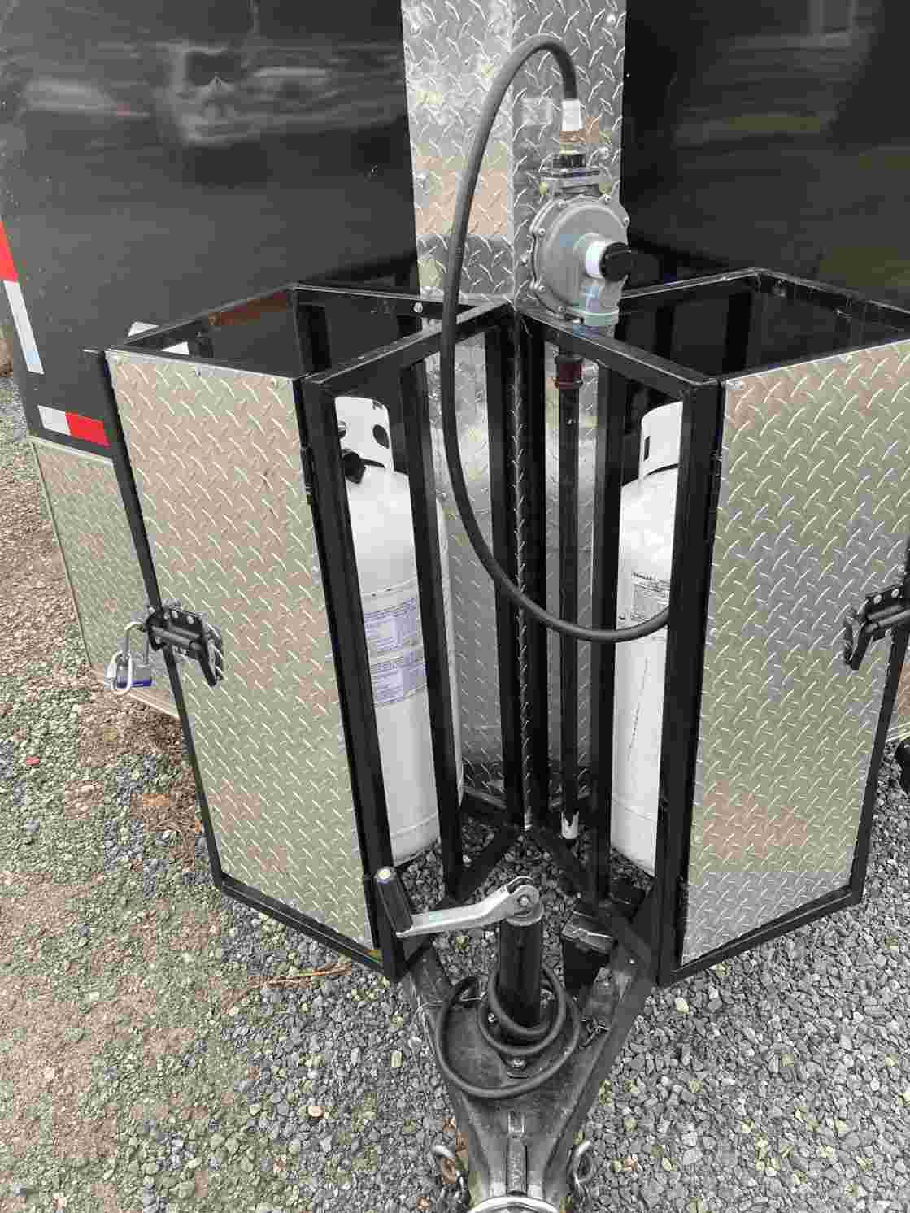
Propane Tank Location/Mounting
Check | Description
 | Containers must be mounted securely to the exterior of the vehicle in an approved area. They cannot be on the front or the side of the unit.
 | Ensure that portable gas containers are in the upright position and secured to prevent tipping over. Containers must be securely mounted to prevent jarring loose, slipping, or rotating.
 | All containers must be protected from damage from loose objects and from damage due to overturns or similar vehicle accidents.
 | A bumper protecting containers mounted on the rear shall extend at least six inches beyond the container and be of substantial fabrication matching or exceeding the strength of the existing bumper for protection of the container in the event of a rear end collision.
 | Path of Egress not blocked in case of emergency
 | Must be at least 10 ft from any ignition source
Notes:
NC Dept of Agriculture Regulations are based on the NFPA 58, Liquefied Petroleum Gas Code: https://www.ncagr.gov/standard/LP/LPgasConcerns/documents/FoodTruckInspectionItems.pdf

Slide 9
Propane Lines/Piping Systems
Check | Description
 | Check that the main shutoff valve on all gas containers is readily accessible.
 | Ensure that portable gas containers are in the upright position and secured to prevent tipping over.
 | Perform leak testing on all new gas connections of the gas system.
 | Perform leak testing on all gas connections affected by replacement of an exchangeable container.
 | Document leak testing and make documentation available for review by the authorized official.
 | Ensure that on gas system piping, a flexible connector is installed between the regulator outlet and the fixed piping system.
Notes:
NC Dept of Agriculture Regulations are based on the NFPA 58, Liquefied Petroleum Gas Code: https://www.ncagr.gov/standard/LP/LPgasConcerns/documents/FoodTruckInspectionItems.pdf

Slide 10
Propane Lines/Piping Systems (cont.)
Check | Description
 | Piping materials used must be approved for LP Gas service. Install a flexible connector between the regulator outlet and the fixed piping system.
 | Piping must be protected from vibration, abrasion, and damage.
 | Piping systems must be tested for leaks at the normal operating pressure to ensure a gas-tight system.
 | Leak tests must be performed after every transit event. Vibrations and bumps may cause fittings to loosen.
 | Leak tests are performed by spraying the joints with an approved liquid leak detecting solution. (Bubble test)
 | If leaks are found, the unit will not be operated until permanently fixed
Bubble Test: https://youtu.be/2GA4vwg8ay4
Notes:
NC Dept of Agriculture Regulations are based on the NFPA 58, Liquefied Petroleum Gas Code: https://www.ncagr.gov/standard/LP/LPgasConcerns/documents/FoodTruckInspectionItems.pdf

Slide 11
Refilling Tanks: The 80% Fill Rule
Propane, like water, will expand when heated but the amount of propane expansion is 17x greater! (For the same volume and temperature change)
If the tank measures 80% full (by volume) on a mild April day, the same tank might be 85% or higher (by volume) at the 4th of July.
Same MASS of propane, but it is taking up a greater VOLUME
Leaving 20% space in the tank is a cushion against pressure buildup during hot weather
Who is refilling your tanks? What method do they use?
Only use professionals who are trained to handle propane, not a local gas station or box store (i.e. can they explain how it works?)
Propane
Gas
Liquid Propane
80%
Capacity
Notes:
→If water expands 1 cm³ for a 20ºF rise, the same amount of propane expands 17 cm³
https://www.amerigas.com/amerigas-blog/propane-tanks/propane-tanks-and-the-80-percent-fill-rule
There is some debate on the best method for determining 80% full. W

Slide 12
Refilling Tanks- Overflow Valve
**Do NOT fill the tank full, and then allow Overflow Valve to release “extra” into the air.
Dangerous in multiple respects:
Will its release be predictable?
When you expect it and in open air? or
When you are at an event with people around?
Where does the released propane go?
It will sink and flow on ground. If an ignition source is nearby…
Propane
Gas
Liquid Propane
80%
Capacity

Slide 13
Refilling- How can I tell if a tank is 80% full?
Find the “Tare Weight” of the tank
Weight the tank when it is empty
Weigh the propane tank before refilling
If tank weighs >Tare Weight, some propane remains
Calculate how much total weight is needed
Tank Weight (Tare) + Propane Weight x 80%
Ex. 18 lb empty + (20 lb x 80%) = 18 lb + 16 lb = 34 lb
Tare: 15 lb
(= tank empty)
Current: 17 lb
(= 15 lb Tank + 2 lb LP)
Total Weight=
Tare Wt + Propane Wt x 80%
Notes:
The 15-pound Tare Weight is just an example. Actual tank weights will vary.

Slide 14
Refilling Propane Tanks- Discussion of Challenges
Topic 1: Small or large tanks (20-100lb)?
Option 1: Smaller tanks
Events? Convenience?
Option 2: Larger tanks
More capacity for busy events?
How easily removed for refill?
Required to be removed for refill?
Issue 2: When and how will tanks be filled?
Option 1: One tank-not full prior to event
“Topping off” tank- acceptable?
Option 2: Two 100 lb tanks
Use one until it’s low, then switch to 2nd tank and fill up 1st tank later
Owners: When you consider options, do you consider safety? And what risks are you willing to expose your business to?
Notes:
Realize that what is allowed may not be the safest option. Local regulations may be slow to be updated.
Taking a tank to be “topped off” may lead to overflow and increased risk

Slide 15
To Summarize:
Propane tanks present a unique hazard to the food truck industry compared to brick-and-mortar restaurants.
Multiple hazard controls should be used to control propane tank hazards.
When refilling propane tanks, the 80%-Fill Rule should be followed.
Companies should only use professionals with propane training and experience for refilling needs and piping installation.

